Slide 1
Child Tax Credit And Credit for Other Dependents
Pub 4012 – Tab G
Pub 4491 – Lesson 25

Slide 2
Lesson Topics
Child tax credit
Taxpayer qualifications
Child qualifications
Special rules for divorced, separated, or never married parents
TaxSlayer entry
Credit for other dependents
Qualifications
Exit Interview

Slide 3
IRS.GOV Resources
IRS YouTube Video: Child Tax Credit and Credit for Other Dependents
Interactive Tax Assistant: Does My Child/Dependent Qualify for the Child Tax Credit or the Credit for Other Dependents?

Slide 4
Child Tax Credit and Additional Child Tax Credit
Child tax credit (CTC) $2,000 per eligible child
Refundable portion up to $1,400
Additional Child Tax Credit (ACTC)
Must have more than $2,500 earned income to qualify for refundable portion
May get refundable portion with three or more children regardless of income

Slide 5
CTC and ACTC Taxpayer Qualifications
Taxpayer and/or Spouse with ITIN or SSN are eligible for CTC and ACTC
Income phase outs – Modified Adjusted Gross Income Limits
Married Filing Jointly - $400,000
All other filing statuses (including MFS) - $200,000
Cannot claim foreign income exclusion
File Form 8862 if a refundable credit was disallowed in prior year and received IRS letter to file the form

Slide 6
CTC and ACTC Child Qualifications
Dependent must be claimed as a Qualifying Child
Cannot be Qualifying Relative
Refer to tri-fold Resource Tool
Under age 17
Disability not a factor
U.S. citizen, national or resident alien
Dependent child must have valid Social Security number by due date of the return

Slide 7
Special Rules for Divorced or Separated Parents
Child can be treated as a dependent of noncustodial parent if all apply
Parents divorced, legally separated or lived apart last 6 months of the year
Child received over half support from one or both parents
Child in custody of one or both parents over half the year
Divorce decree or written separation agreement states noncustodial parent may claim exemption
Signed Form 8332 or pre-2009 divorce decree attached to the return
No need to memorize – use Tri-fold Resource Tool
Notes:
Signed Form 8332 releases dependency exemption to non-custodial parent
Post-1984 and Pre-2009 divorce decree rules exist and should be researched when applicable. Rules are in Pub 4012 Tab G and Form 1040 Schedule 3 instructions
Post-2008 divorce cannot include decree with return – MUST include signed Form 8332

Slide 8
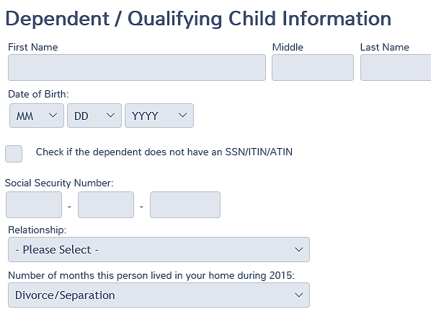
Entering in TaxSlayer
In case of divorce or separation:
Noncustodial parent enters “Divorce/Separation” from drop down menu for number of months in home
Notes:
In order to have the Child Tax Credit applied to the noncustodial parent, Divorce/Separated must be selected from the dropdown menu for number of months in the home.

Slide 9
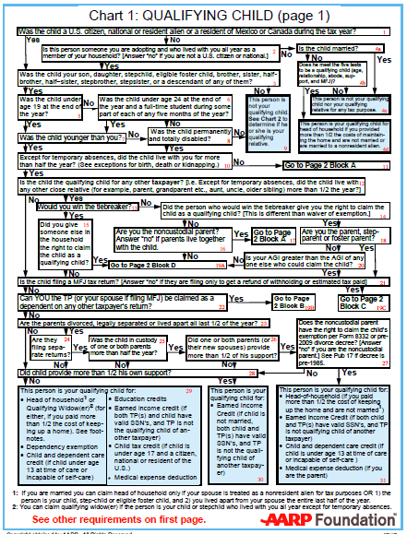
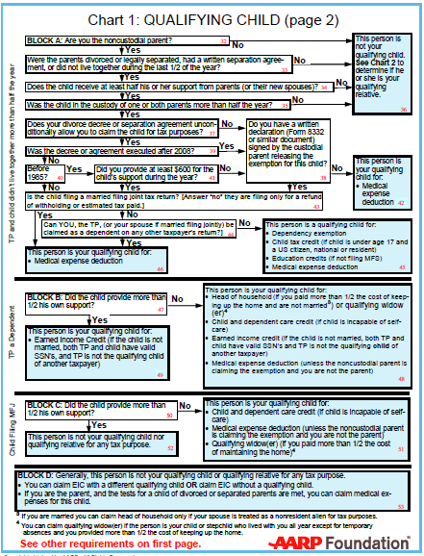
Qualifying Child Tri-fold
Use the Tri-fold to verify eligibility for CTC/ ACTC
Notes:
Credit goes with the dependency exemption. Must be qualifying child—not qualifying relative. If the custodial parent releases the exemption, non-custodial parent eligible for the child tax credit.

Slide 10
Child Tax Credit and TaxSlayer
Credit based on information entered
TaxSlayer automatically computes credit based on entries

Slide 11
Credit for Other Dependents

Slide 12
Credit for Other Dependents
Available for claimed dependents that do not qualify for Child Tax Credit
May be Qualifying Child or Qualifying Relative
Includes dependents age 17 or older
Qualifying dependent may have Social Security number or ITIN
Must be U.S. citizen, U.S. national, or U.S. resident alien

Slide 13
Credit for Other Dependents
$500 per qualifying dependent
Nonrefundable credit
Income phase out
Married Filing Jointly - $400,000
All other filing statuses - $200,000
Credit not allowed for taxpayer or spouse
TaxSlayer automatically computes credit based on entries
Notes:
Like CTC, TaxSlayer computes automatically based on information entered in dependent section
Taxpayers used to be able to claim their spouse’s exemption deduction in certain cases
That deduction is gone and there is no offsetting replacement

Slide 14
Exit Interview
Advise taxpayers CTC/ACTC goes away the year child turns 17
Disability is not a factor
$500 Credit for Other Dependents available when CTC does not apply

Slide 15
Child Tax Credit, Additional Child Tax Credit and Credit for Other Dependents

